Slide 1


Microsoft Azure Machine Learning
Arief Bavan(Data Solution Architect)
Vicky Fu (Data Scientist)
Microsoft

Slide 2
Agenda
Microsoft AI Journey
Cortana Intelligence Suite.
Machine Learning Overview
Machine Learning Workshop (2 Approaches)
Using a Data Science Virtual Machine. (Infrastructure as a Service)
Using an Azure ML Studio (Platform as a Service)
Microsoft Deep Learning((Time permitting)
Notes:
https://www.youtube.com/watch?v=rVF2duPVUTY
Note for DP hackathon Dec 2nd
See AI Project. https://www.youtube.com/watch?v=rVF2duPVUTY 0-3:46 (A) 5mins
Cortana Intelligence Suite (A) 10min
Machine Learning Overview (V)10m
Data Science VM intro(A) 30min
Demo Data Science VM and ML (V) 30min
Azure ML studio (V) 120min

Slide 3
Microsoft & Machine Learning Answering questions with experience
1991
1997
2008
2009
2010
2014
2015
Microsoft Research formed
Hotmail launches
Which email is junk?
Bing maps launches
What’s the best way home?
Bing search launches
Which searches are most relevant?
Kinect launches
What does that motion “mean”?
Skype Translator launches
What is that person saying?
Azure Machine Learning GA
What will happen next?
Machine learning is pervasive throughout Microsoft products.
Notes:
Microsoft has been working on machine learning for over two decades. We formed Microsoft research back in 1991 to tackle the tough problems internally that we’re enabling you to tackle yourselves today.
When we think of learning from experience – past data + human input – a great example is Hotmail. Back in 1997, external email was a relatively new concept. There wasn’t a lot to go on in terms of what email the customer wants and what they do not. With the rise of email, also came spam – and lots of it. Some of those issues were easy – like Nigerian princes we learned pretty quickly don’t give away their fortunes to strangers. But what about “free offer” – maybe that free offer is something the customer always wanted. Maybe it’s something they’d never want. But that’s where the “human input” part comes in as data is being collected – that takes the form of the actual user of the email service saying “yes, this is junk” or “no, I want this” and then the data scientist learning in aggregate and making tweaks to the underlying model in response.
And we kept going with that learning – relying on past data and human input to solve problems like the best way home, which search results are most meaningful to the user and one of the toughest ones to tackle with Kinect. Kinect’s past data was all in the lab – we didn’t have a product in market that captured user input and translated that to active game play so we had to make up the variables. But that only takes us so far. The researchers told me that one thing they didn’t consider was people answering the phone while playing. This happens a lot – and Kinect at first was translating this as a wild motion in the game play – essentially crashing people’s cars or any number of unintended consequences. That was the human input we rely on, which allowed us to learn quickly and adjust the underlying model to ensure that answering the phone would not be considered part of the game moving forward.
Skype translator is another huge machine learning problem to solve if you think of all the ways a person who is speaking English can pronounce the same word – tom-A-to or tom-AH-to – that’s the same word in French so Skype has to adjust quickly to ensure all the millions of variables are considered.
But what about using all this learning to predict what’s next? Many of the same algorithms running behind the scenes of our products in market today are available within Azure ML, allowing you to take your own past data and learn from it what will happen in the future for your business.

Slide 4
Cortana Intelligence Suite Transform data into intelligent action
Information Management
Big Data Stores
Machine Learning and Analytics
Intelligence
Data Sources
People
Data Factory
Data Lake Store
Machine Learning
Cognitive Services
Data Catalog
SQL Data
Warehouse
Data Lake Analytics
Bot Framework
Web
Apps
HDInsight
(Hadoop and Spark)
Event Hubs
Cortana
Mobile
Apps
Stream Analytics
Bots
Dashboards & Visualizations
Sensors and devices
Power BI
Automated Systems
Data
Intelligence
Action

Slide 5
Agenda
Microsoft AI Journey.
Cortana Intelligence Suite.
Machine Learning Overview
Machine Learning Workshop (2 Approaches)
Using a Data Science Virtual Machine. (Infrastructure as a Service)
Using an Azure ML Studio (Platform as a Service)
Microsoft Deep Learning

Slide 6
What is Machine Learning?
Computing systems that become smarter with experience
“Experience” = past data + human input
“
I need our systems to think. I need them to learn and I need them to present issues and problems and anomalies to the employees, to the managers.
Adam Coffey President and CEO
WASH Laundry Systems
”
Notes:
Machine Learning is a term that is not widely understood, perhaps you think of it as artificial intelligence or robotics or any number of things. It’s helpful to start with how Microsoft thinks of machine learning. Machine learning means computers that become smarter with experience. What do we mean by experience?
Experience is past data + human input. And that past data is often huge – the quantity of data is doubling about every 18 months and that’s only increasing from here. Computers can consider far more variables than a human making the same decision.
And what do we mean by human input? Human input takes two forms – the input of the user who is either communicating that the output is what they are looking to see or not. In the case that it’s not, the machine can either self-adjust to deliver better results moving forward or the advanced analytic developer or data scientist can make those changes to the model. Let’s look at examples from our own work over many years.
WASH video:
https://www.youtube.com/watch?v=iIYU1Xfhr8g&feature=youtu.be

Slide 7
Machine Learning is not…
Methods and Systems that …
perform good predictions without data modeling & feature engineering
Silver-bullet for all data-driven tasks – it’s a powerful data tool!
are a replacement for business rules – they augment them!
can yield Garbage-In-Knowledge-Out

Slide 8
Why Learn?
Learn it when you can’t code it
(e.g. Recognizing Speech/image/gestures)
Learn it when you can’t scale it
(e.g. Recommendations, Spam & Fraud detection)
Learn it when you have to adapt/personalize (e.g. Predictive typing)
Learn it when you can’t track it (e.g. AI gaming, robot control)
Notes:
Instead of code

Slide 9
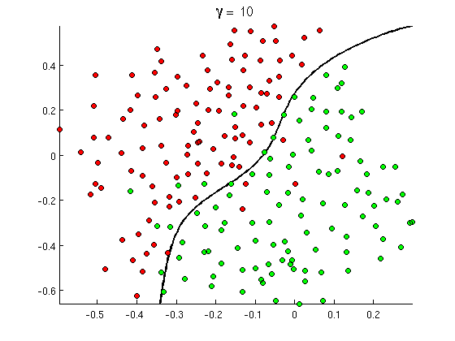
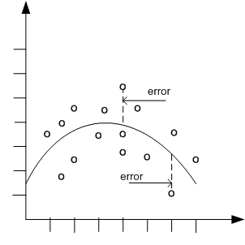

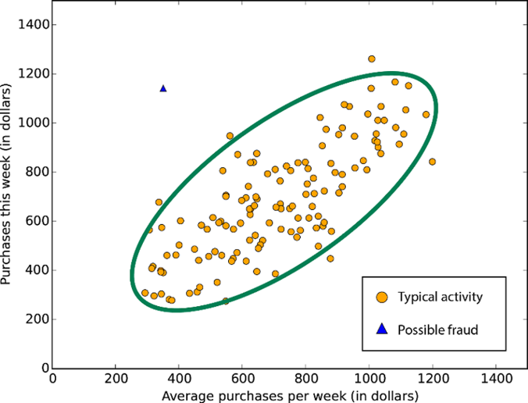
Common Classes of Problems
Classification
Regression
Recommenders
Anomaly
Detection
Notes:
http://openclassroom.stanford.edu/MainFolder/courses/MachineLearning/exercises/ex8materials/ex8b_10.png
http://docs.oracle.com/cd/B28359_01/datamine.111/b28129/img/scatter_plot_nonlinear.gif
http://spectrum.ieee.org/img/RecommendNEWf1-1348253703748.jpg

Slide 10
Agenda
Microsoft AI Journey.
Cortana Intelligence Suite.
Machine Learning Overview
Machine Learning Workshop (2 Approaches)
Using a Data Science Virtual Machine. (Infrastructure as a Service)
Using an Azure ML Studio (Platform as a Service)
Microsoft Deep Learning
https://www.youtube.com/watch?v=rVF2duPVUTY

Slide 11
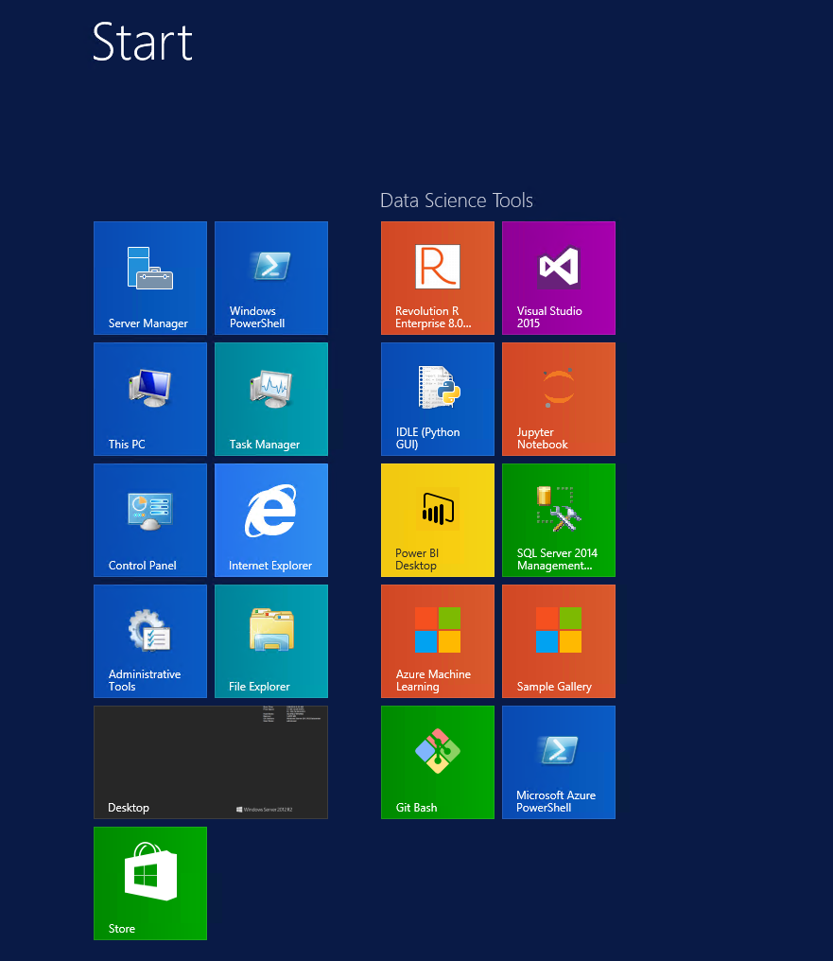
What is Data Science Virtual Machine?
Custom VM image on Azure Marketplace
Contains a set of data science, Azure tools/SDKs
All pre-configured and ready to use
Pay for cloud hardware usage only. No separate software charges!
Pointers to gallery, samples, documentation
Windows and Linux Versions
Up and running quickly

Slide 12
Usage Scenarios
Onprem Analytics desktop replacement in the cloud
Consistent setup across team, promote sharing and collaboration
Azure scale and management
Near-Zero Setup
Dedicated on-demand elastic capacity for large workloads
Ability to run analytics not feasible on desktop or on shared environment
Pay for what you use
Eg: Hackathons, Competitions
Data Science Training and education
Consistent setup, ease of support
On Demand, Shared / dedicated infrastructure
Quick, Low friction startup
Short Experiments & Evaluation
Quick, Low Friction startup
Spend time evaluating instead of setup
Try before you buy
Replicate a published experiment

Slide 13


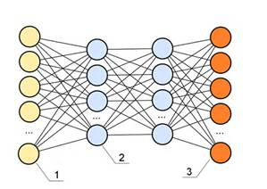










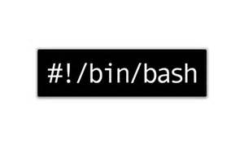
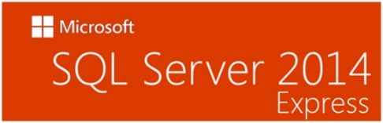



What’s included?
xgboost
Vowpal Wabbit
CNTK
Rattle

Slide 14
Machine Learning Workshop: Data Science VM

Slide 15
Machine Learning Process Model
Idea
Data
Business Knowledge
Data Understanding
Data Preparation
Modelling
Evaluation
Publish
Based on the CRISP-DM Model
Re-train

Slide 16


Machine Learning the hard way
Python
Scikit-learn
Classification Example

Slide 17
Agenda
Microsoft AI Journey.
Cortana Intelligence Suite.
Machine Learning Overview
Machine Learning Workshop (2 Approaches)
Using a Data Science Virtual Machine. (Infrastructure as a Service)
Using an Azure ML Studio (Platform as a Service) https://studio.azureml.net/
Microsoft Deep Learning
https://www.youtube.com/watch?v=rVF2duPVUTY

Slide 18
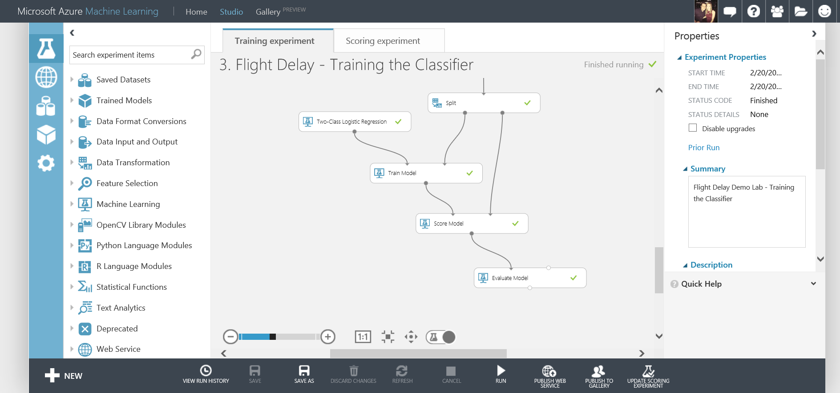
What is Azure Machine Learning
Fully managed cloud service
Accessed via a browser
Best in class machine learning algorithms
Support for R/Python/SQL
Collaborative data science
Quickly deploy models as web services
Publish to a Gallery

Slide 19
Azure Machine Learning Service Data -> Predictive model -> Operational web API in minutes
Data
Clients
API
ML STUDIO
Model is now a web service that is callable
Blobs and Tables
Hadoop (HDInsight)
Relational DB (Azure SQL DB)
Integrated development environment for Machine Learning
Monetize the API through our marketplace
Notes:
So let’s take a look at the technology itself. The elegance of the solution is in its simplicity – something that has been lacking in the machine learning space which is a key reason this space has not improved in generations. But we are here to change this.
The first issue many enterprises face is data ingestion. With the cloud, you can bring in data sources with the ease of a drop down or drop your on-premises data set into the built in storage space. Users can then model in our development environment – Machine Learning Studio – where we’re offering R, Python and SQLite as first class citizens in addition to our world-class Microsoft algorithms.
The second issue – and often the primary one – is putting finished work into production in a way others can use. We’ve heard from many data scientists that they model in R on a Linux stack but then have to hand over their work to developers who need to translate that into another language to actually make it work. This time consuming and unnecessary process has been eliminated with our system, as the model is with a click transformed into a web service end-point that can run over any data, anywhere and connect to any solution or client.
Next, not only can this model be put into production for your company, it can be made available for the world on our Machine Learning Marketplace. Microsoft hosts your solution and markets it for you, while you have the freedom to brand and monetize as you see fit. We also offer a number of Microsoft solutions here.

Slide 20
Our Scenario
Create and publish a model that predicts:
Will a flight be delayed given a range of flight details and weather data.
Using two datasets: flight delay data and weather data
The model created will be a form of Supervised Learning and will use Binary Classification
Use historical flight and weather data to predict if a future flight is delayed or not.
Finally produce a web service you can query with new flights to gain a prediction

Slide 21
Azure ML Studio Lab
http://aka.ms/cortanamanual
Flight Delay Scenario
Data Source: http://aka.ms/awtdata
Notes:
http://aka.ms/techdaymltrack

Slide 22
Azure ML Studio Demo
Retrain Machine Learning Models
More information:
https://azure.microsoft.com/en-us/documentation/articles/machine-learning-retrain-models-programmatically/

Slide 23
Agenda
Microsoft AI Journey.
Cortana Intelligence Suite.
Machine Learning Overview
Machine Learning Workshop (2 Approaches)
Using a Data Science Virtual Machine. (Infrastructure as a Service)
Using an Azure ML Studio (Platform as a Service)
Microsoft Deep Learning
Notes:
https://www.youtube.com/watch?v=rVF2duPVUTY

Slide 24




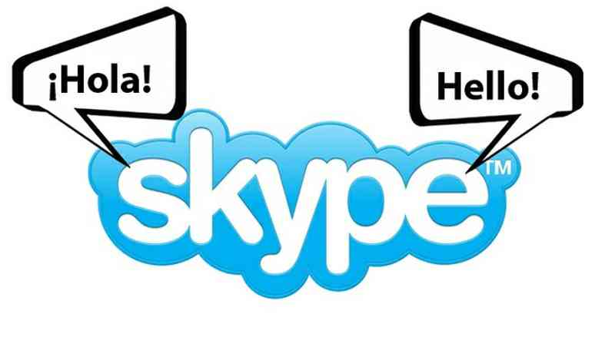


Deep Learning in Microsoft
Cognitive Services
https://how-old.net
http://www.captionbot.ai
Skype Translator
Bing
Cortana
ads
relevance
multimedia
…
HoloLens
Microsoft Research
speech, image, text

Slide 25
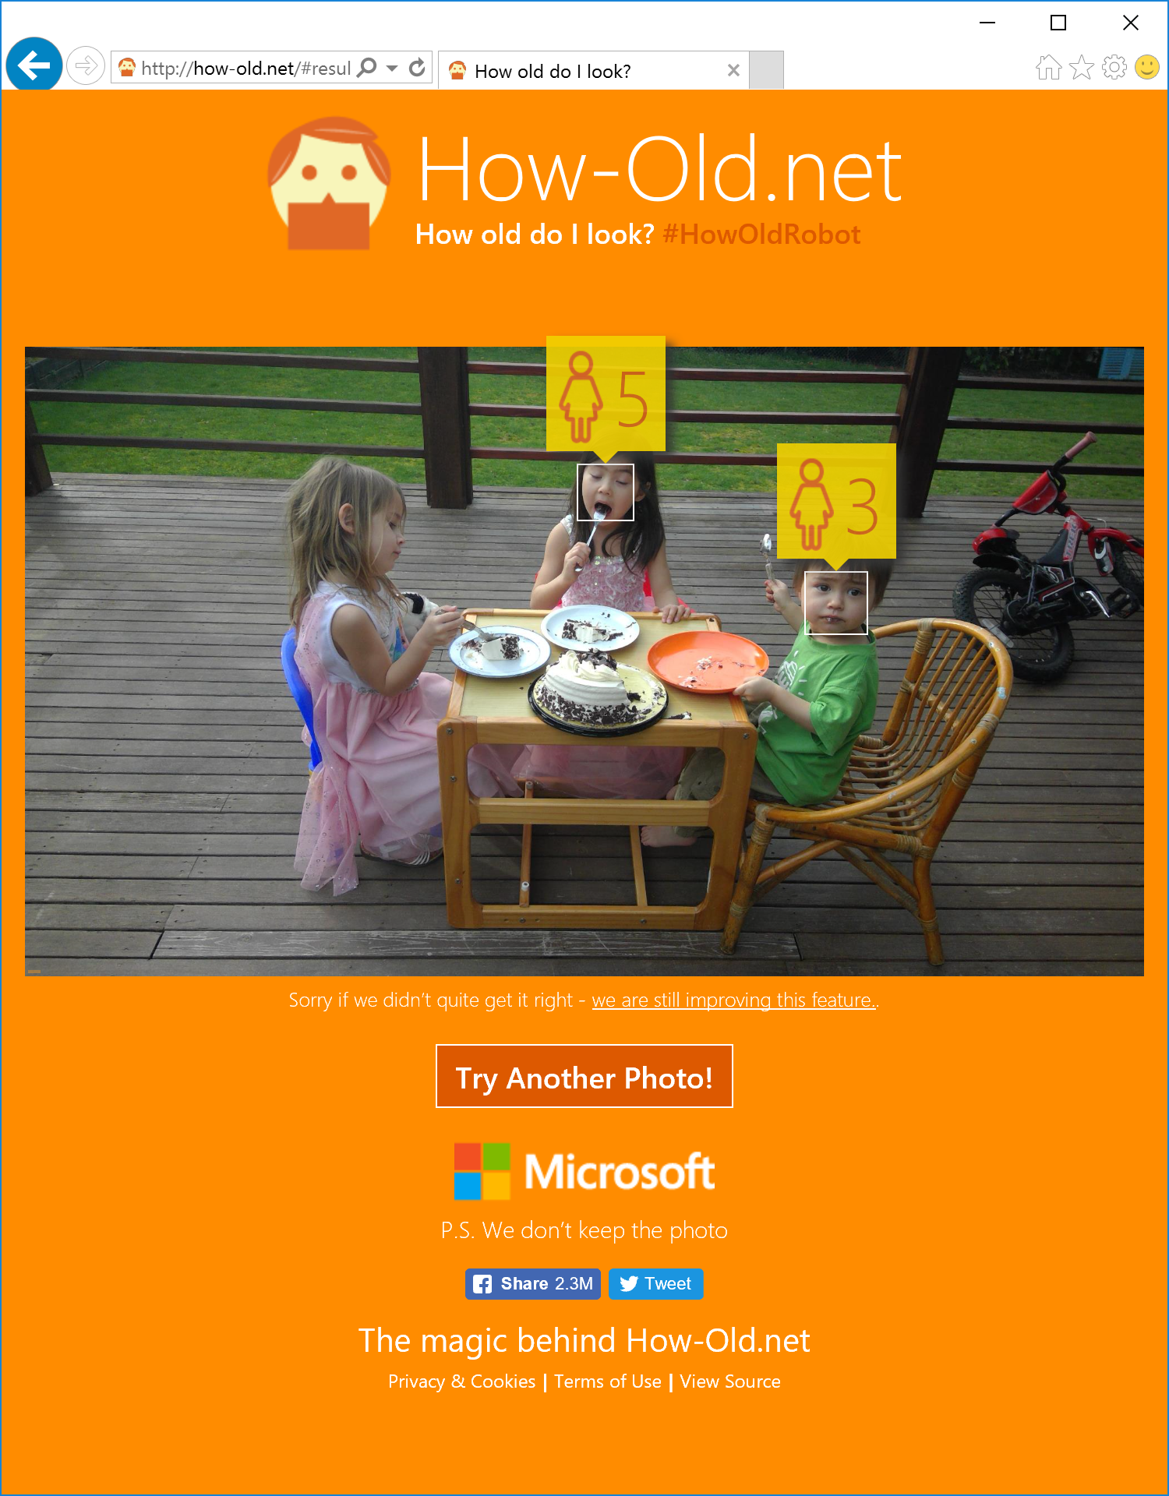
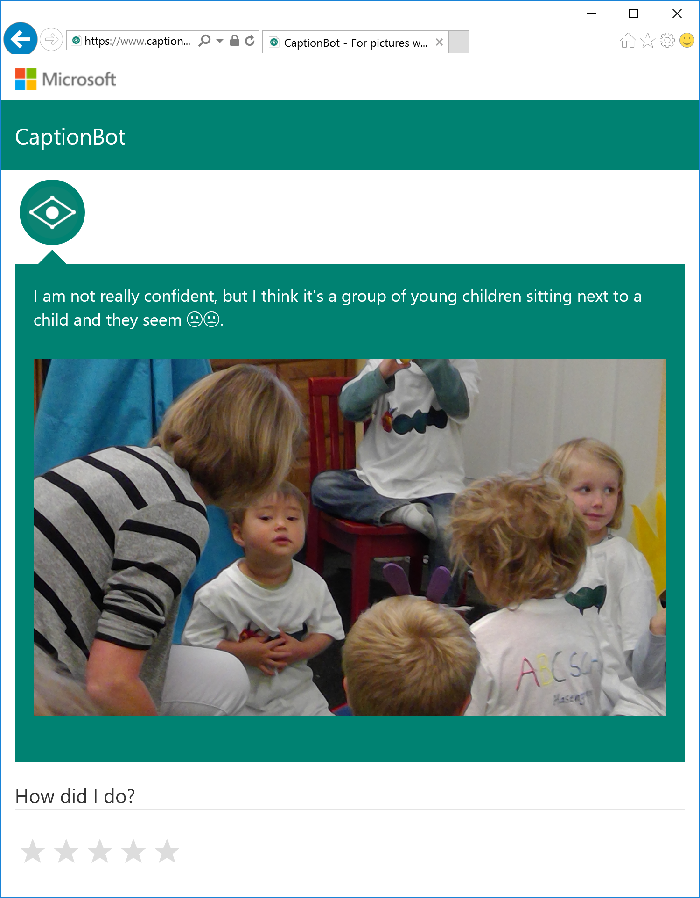

Slide 26
ImageNet: Microsoft 2015 ResNet
Microsoft had all 5 entries being the 1-st places this year: ImageNet classification, ImageNet localization, ImageNet detection, COCO detection, and COCO segmentation

Slide 27

Microsoft Cognitive Services preview
Vision
Computer Vision | Emotion | Face | Video
Cognitive Services
Give your solutions a human side
Speech
Custom Recognition | Speaker Recognition Speech
Language
Bing Spell Check | Language Understanding Linguistic Analysis | Text Analytics | Web Language Model
Knowledge
Academic Knowledge | Entity Linking Knowledge Exploration | Recommendations
Search
Bing Auto Suggest | Bing Image Search | Bing News Search Bing Video Search | Bing Web Search

Slide 28
Microsoft Cognitive Services preview
Vision
From faces to feelings, allow your apps to understand images and video
Cognitive Services
Give your solutions a human side
Speech
Hear and speak to your users by filtering noise, identifying speakers, and understanding intent
Language
Process text and learn how to recognize what users want
Knowledge
Tap into rich knowledge amassed from the web, academia, or your own data
Search
Access billions of web pages, images, videos, and news with the power of Bing APIs

Slide 29
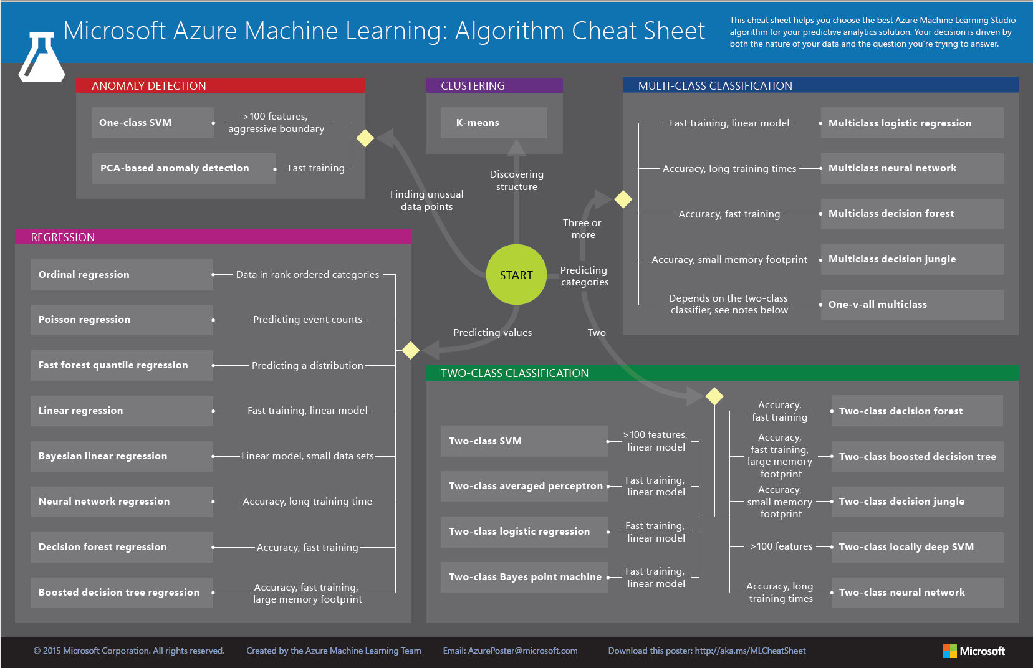

Slide 30
Machine Learning API’s
Cognitive Services
https://www.microsoft.com/cognitive-services

Slide 31
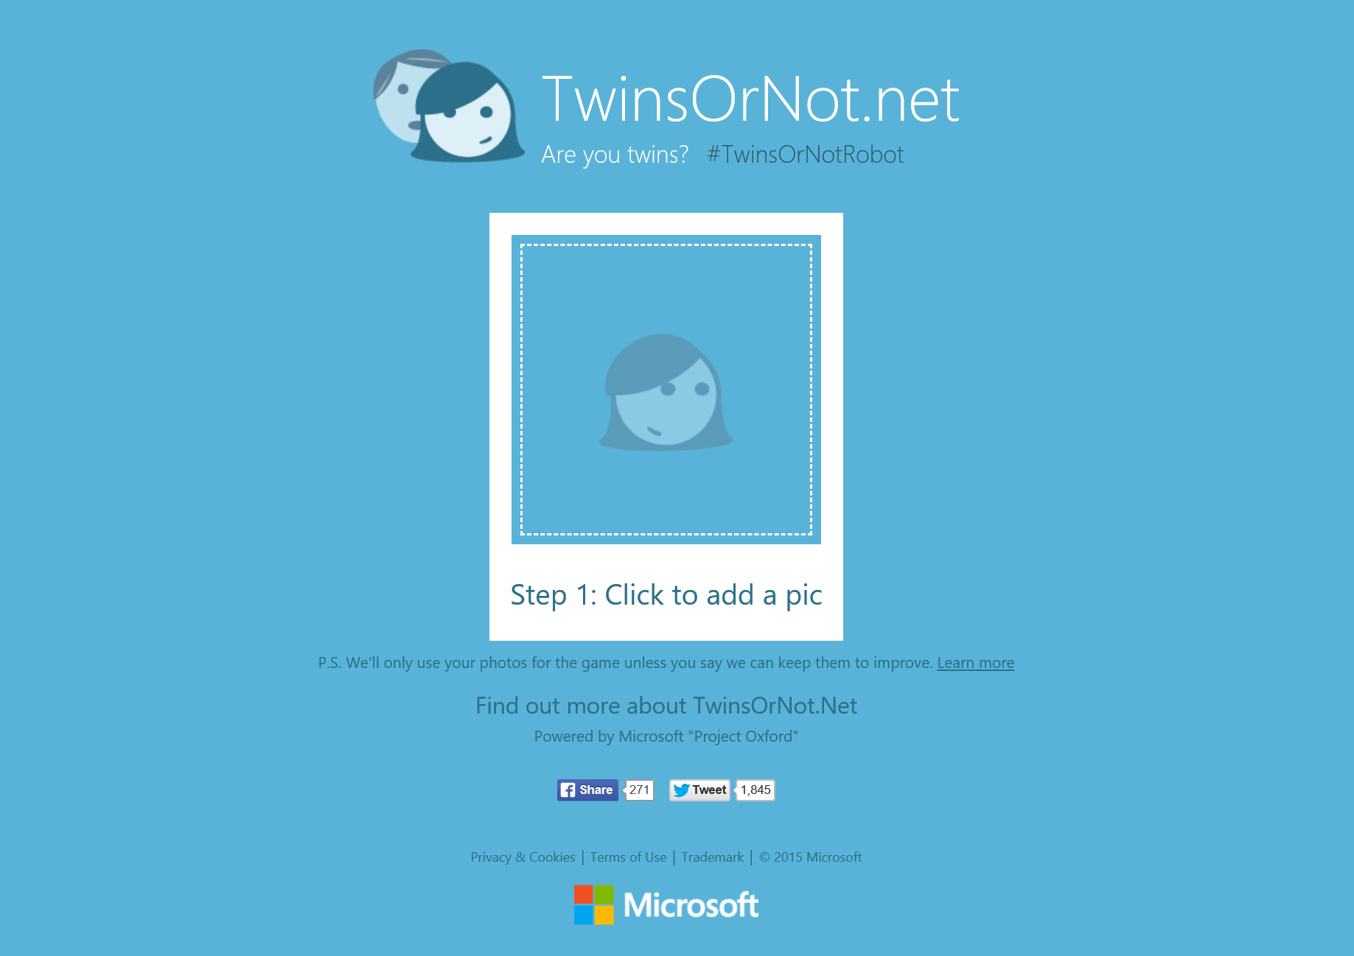

Slide 32
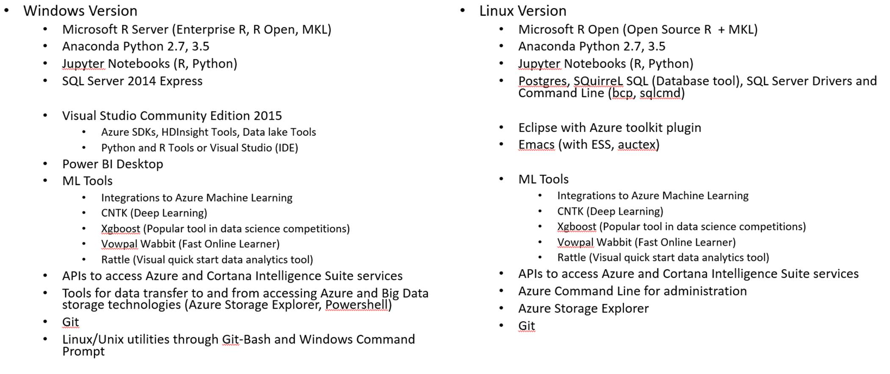
VM Versions comparison

Slide 33
Azure ML Notebooks
R and Jupiter Notebooks
More information:
https://gallery.cortanaintelligence.com/notebooks

Slide 34
Machine Learning Process Model
Idea
Data
Business Knowledge
Data Understanding
Data Preparation
Modelling
Evaluation
Publish
Based on the CRISP-DM Model
Re-train

